Slide 1
Elliptic Curve Cryptography
분산네트워크 연구실 32731 김희주
트러스트 메타버스 실현을 위한 블록체인 융합기술 과제

Slide 2
Public-key cryptography
ECC (Elliptic Curve Cryptography)
기본적인 타원곡선 암호
ECDH (Elliptic Curve Diffie-Hellman)
기존에 있던 Diffie-Hellman 방법에 타원곡선 적용
공개키가 영구적이면 ECDH, 반영구적이면 ECDHE
ECDSA (Elliptic Curve Digital Signature Algorihm)
전자 서명 방식에 타원곡선 적용
대칭 키 공유를 위해 ECDH 사용

Slide 3
ECC 사용 범위
TLS
표준 인터넷 프로토콜
PGP(Pretty Good Privacy)
컴퓨터 파일 암복호화 프로그램, 이메일 보안 표준
SSH(Secure Shell)
원격 호스트에 접속하기 위해 사용하는 보안 프로토콜
Bitcoin
ECDSA 알고리즘 응용한 Secp256k1 암호 사용

Slide 4
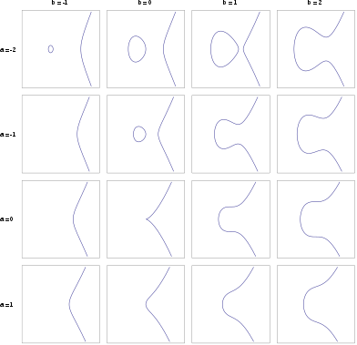
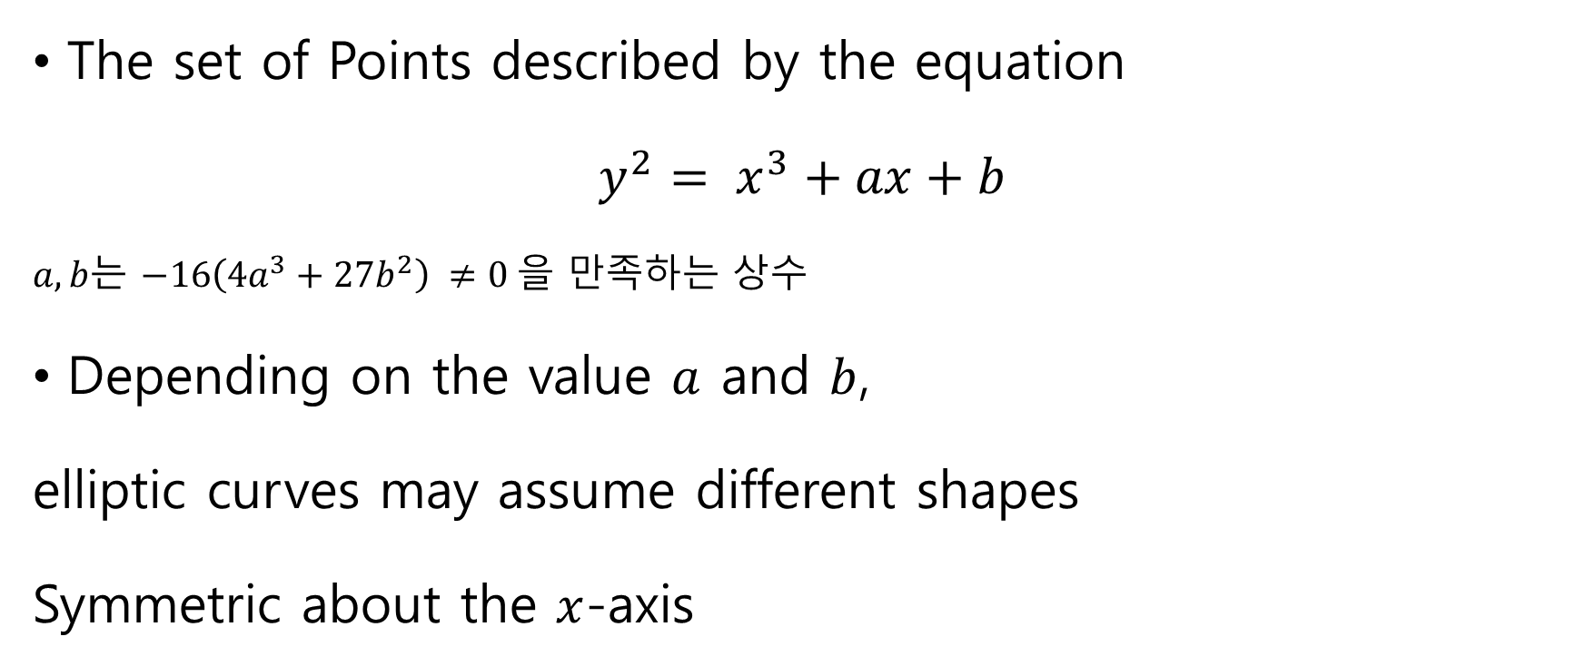
Elliptic Curves
The set of Points described by the equation
$y^{2}= x^{3}+ax+b$
$a, b는$ $−16\left(4a^{3}+27b^{2}\right) ≠0$을 만족하는 상수
Depending on the value $a$ and $b$,
elliptic curves may assume different shapes
Symmetric about the $x$-axis
Notes:
타원곡선은 다음 방정식을 만족하는 점들의 집합입니다.
4a3+27b2​=0 은 타원곡선 상에 singular point가 존재하지 않기 위한 필요충분조건

Slide 5
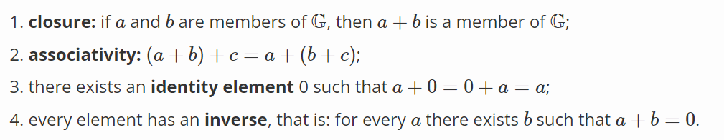

Groups
Group in mathematics is a set for “addition” (+)
We must define addition in order to set group with four properties
If we add a fifth requirement, the the group is called abelian group.
> 해당 정의에 따르면, 정수는 그룹이 될 수 있지만 자연수는 4번 조건을 만족하지 않기 때문에 그룹이 될 수 없음
Notes:
타원곡선 상의 점들은 위에서 정의한 점들의 덧셈에 대해 군(group)을 형성하게 됩니다. 추가적으로, 타원곡선 상에서 점들의 덧셈은 교환법칙(commutative law)를 만족하기 때문에 abelian group을 형성합니다.

Slide 6
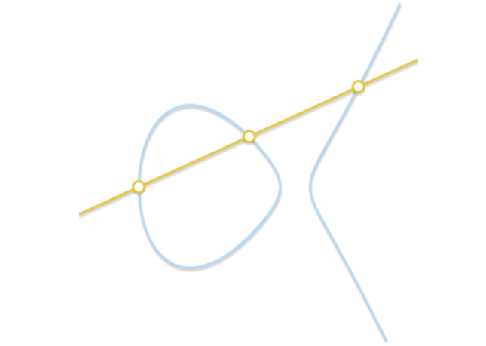
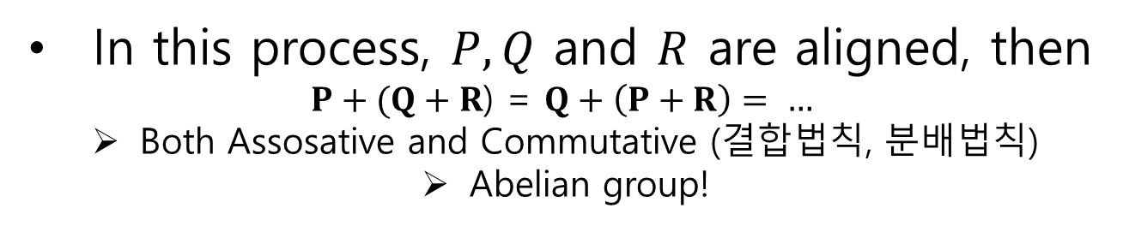
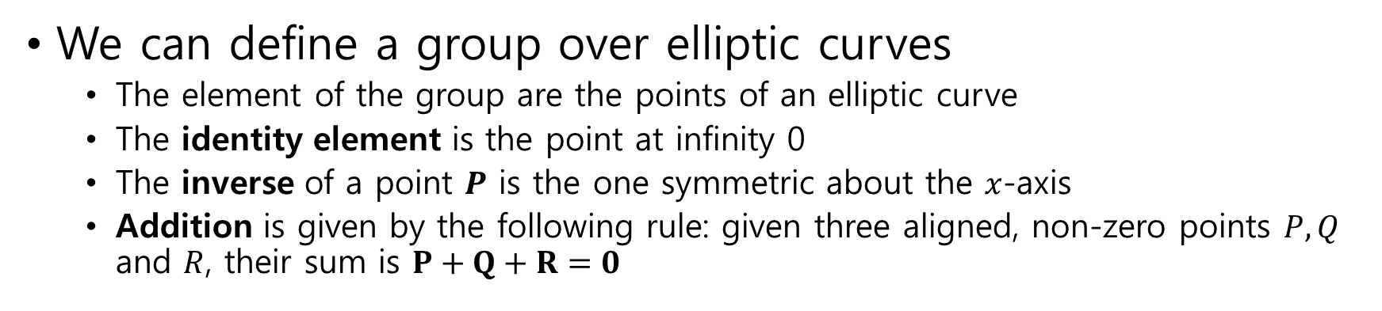
The group law for elliptic curves
We can define a group over elliptic curves
The element of the group are the points of an elliptic curve
The identity element is the point at infinity 0
The inverse of a point $P$ is the one symmetric about the $x$-axis
Addition is given by the following rule: given three aligned, non-zero points $P, Q$ and $R$, their sum is $P+Q+R=0$
In this process, $P, Q$ and $R$ are aligned, then
$P+(Q+R$) = $Q+\left(P+R\right)= …$
Both Assosative and Commutative (결합법칙, 분배법칙)
Abelian group!
$P, Q$ 가 타원 곡선 위 임의의 두 점일 경우, 두 점을 지나는 직선은 $P, Q$ 어느쪽에서 그리던 상관 없기 때문에 교환법칙 성립

Slide 7
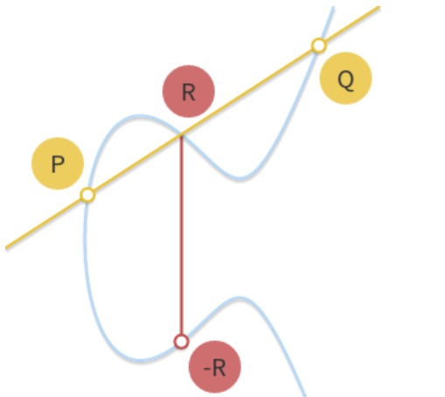
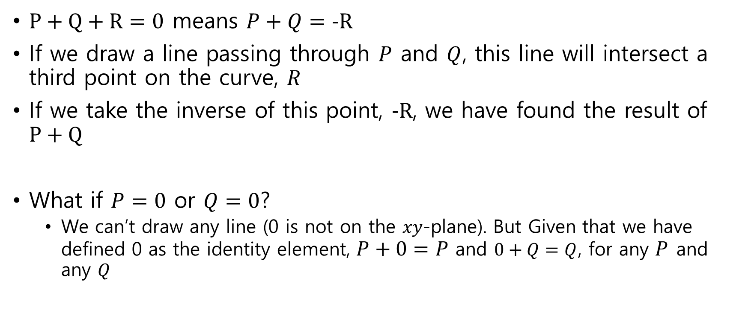
Geometric addition
$P+Q+R=0$ means $P+Q=−R$
If we draw a line passing through $P$ and $Q$, this line will intersect a third point on the curve, $R$
If we take the inverse of this point, $−R$, we have found the result of $P+Q$
What if $P=0$ or $Q=0$?
We can’t draw any line (0 is not on the $xy$-plane). But Given that we have defined 0 as the identity element, $P+0=P$ and $0+Q=Q$, for any $P$ and any $Q$

Slide 8
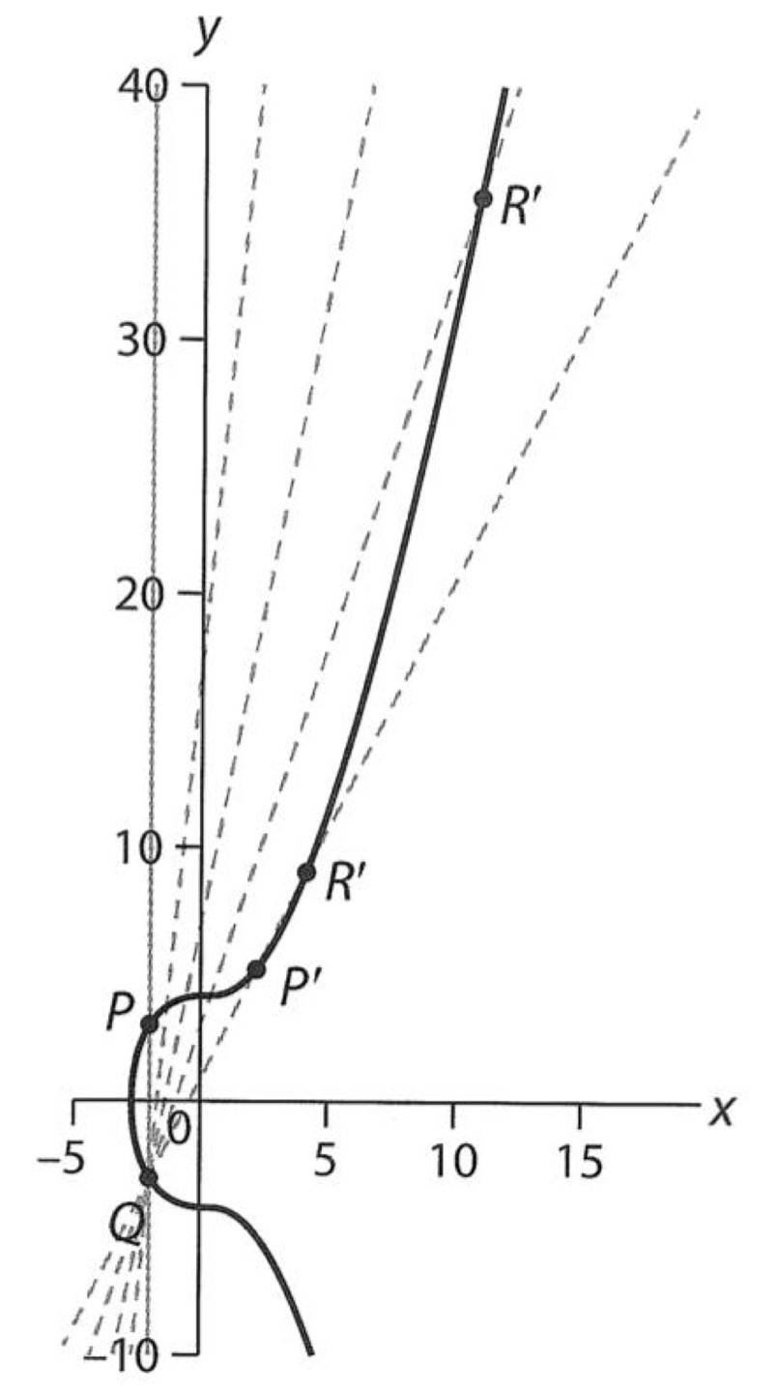
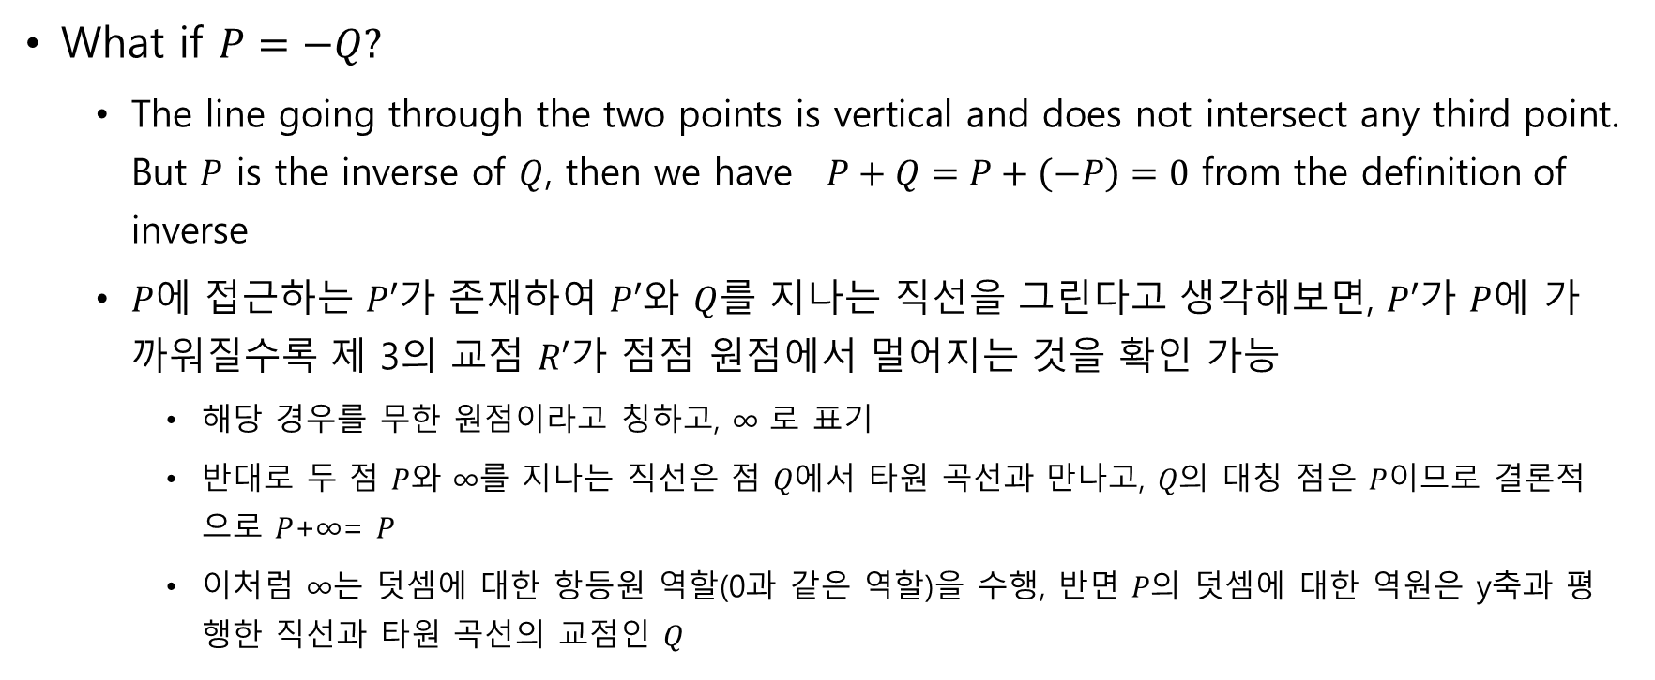
Geometric addition
What if $P=−Q?$
The line going through the two points is vertical and does not intersect any third point. But $P$ is the inverse of $Q$, then we have $P+Q=P+\left(−P\right)=0$ from the definition of inverse
$P에$ 접근하는 $P′$가 존재하여 $P′$와 $Q$를 지나는 직선을 그린다고 생각해보면, $P′$가 $P$에 가까워질수록 제 3의 교점 $R′$가 점점 원점에서 멀어지는 것을 확인 가능
해당 경우를 무한 원점이라고 칭하고, ∞ 로 표기
반대로 두 점 $P$와 ∞를 지나는 직선은 점 $Q에$서 타원 곡선과 만나고, $Q의$ 대칭 점은 $P$이므로 결론적으로 $P$+∞= $P$
이처럼 ∞는 덧셈에 대한 항등원 역할(0과 같은 역할)을 수행, 반면 $P의$ 덧셈에 대한 역원은 y축과 평행한 직선과 타원 곡선의 교점인 $Q$

Slide 9
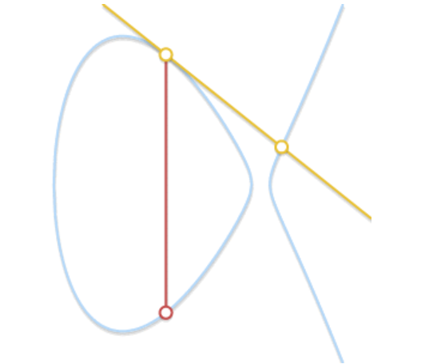
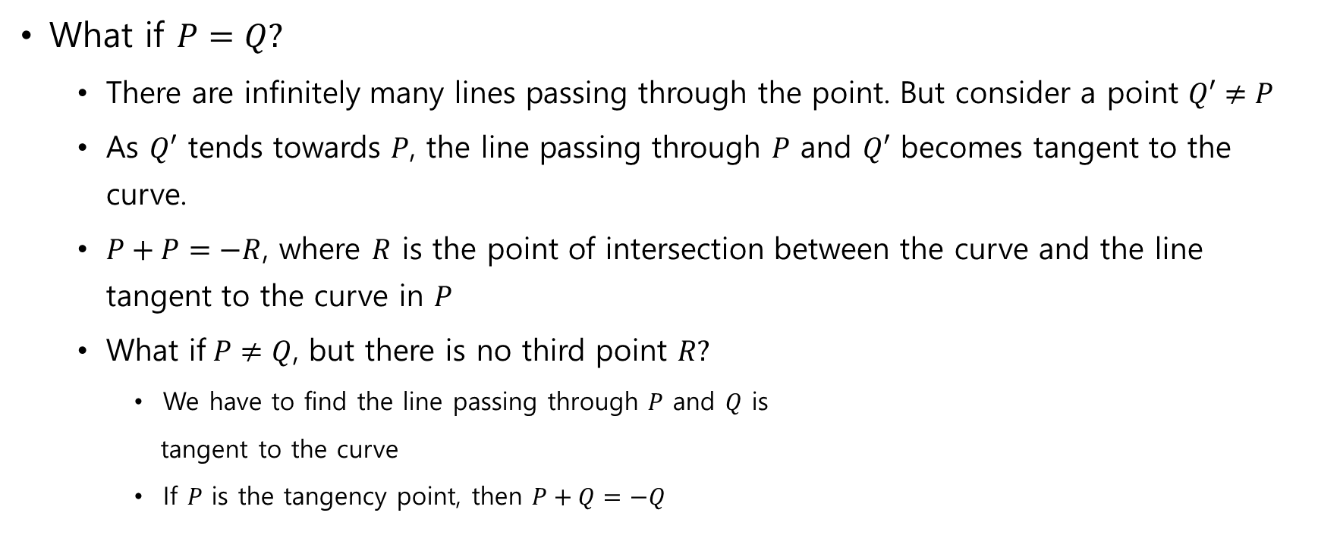
Geometric addition
What if $P=Q?$
There are infinitely many lines passing through the point. But consider a point $Q′≠P$
As $Q′$ tends towards $P$, the line passing through $P$ and $Q′$ becomes tangent to the curve.
$P+P=−R$, where $R$ is the point of intersection between the curve and the line tangent to the curve in $P$
What if$P≠Q$, but there is no third point $R?$
We have to find the line passing through $P$ and $Q$ is
tangent to the curve
If $P$ is the tangency point, then $P+Q=−Q$
If line intersects just two points,
it means that it’s tangent to the curve

Slide 10
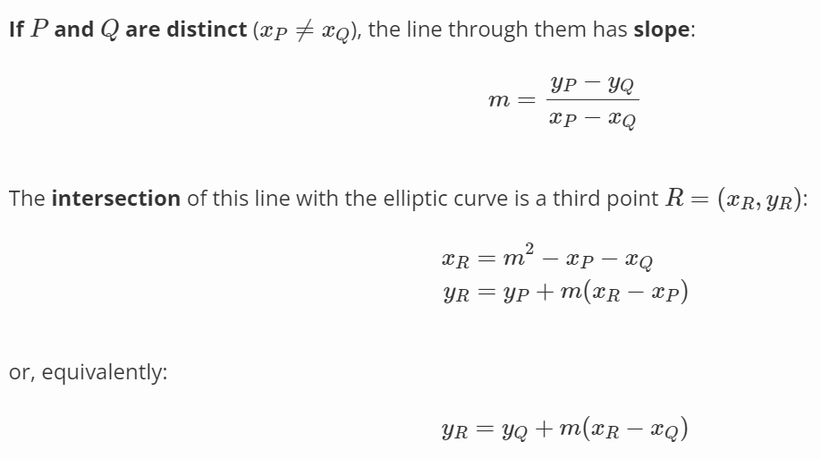



Algebraic addition
If we want a computer to perform point addition, we need to turn the geometric method into an algebraic method
Consider $P=$ $(x_{P },y_{P})$ and $Q=(x_{Q },y_{Q})$are two non-zero, non-symmetric points
$m$ = 기울기
$교$점
Notes:
교점 구하는 식은 왜 저렇게 되는가.. 그래프 구하는 식은 일차방정식과 동일

Slide 11
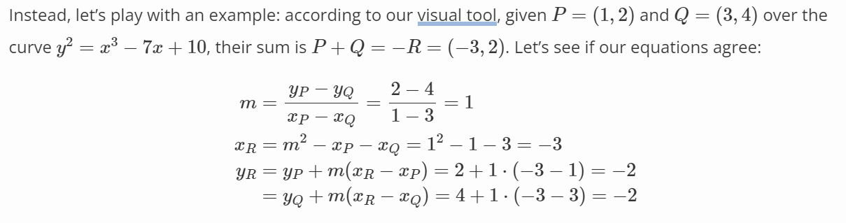
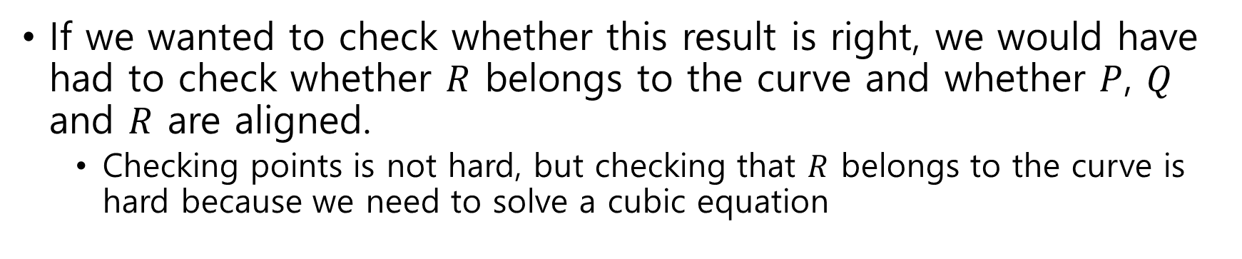
Algebraic addition
If we wanted to check whether this result is right, we would have had to check whether $R$ belongs to the curve and whether $P$, $Q$ and $R$ are aligned.
Checking points is not hard, but checking that $R$ belongs to the curve is hard because we need to solve a cubic equation

Slide 12
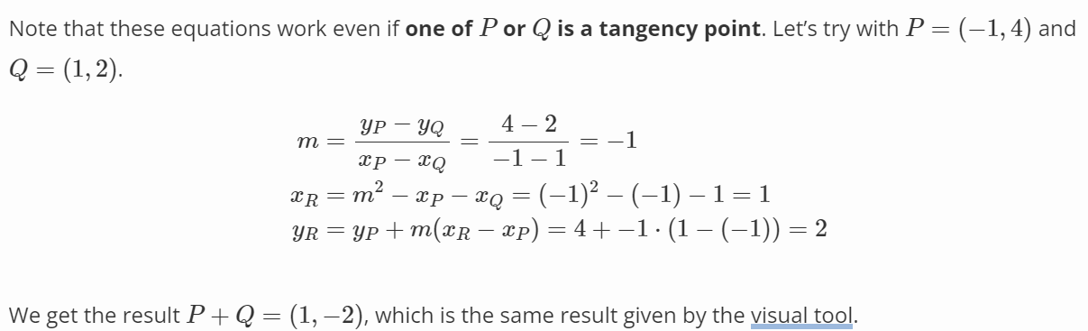
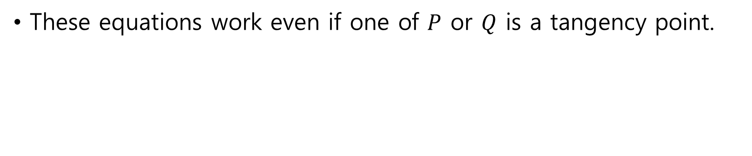

Algebraic addition
These equations work even if one of $P$ or $Q$ is a tangency point.
$$P+Q=−R$$

Slide 13
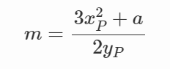

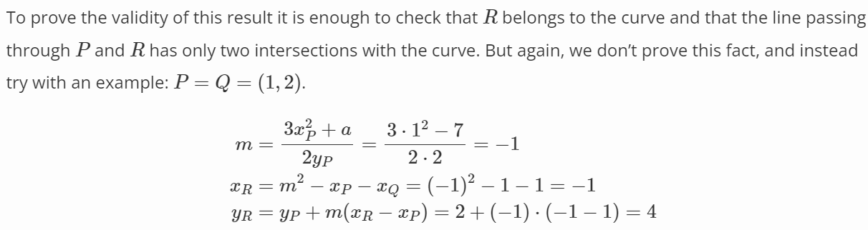

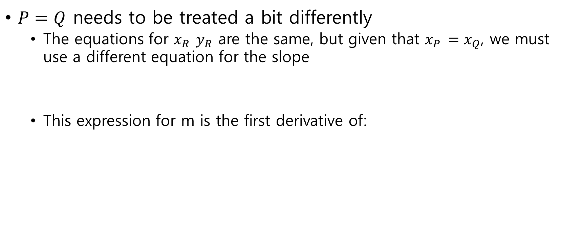
Algebraic addition
$P=Q$ needs to be treated a bit differently
The equations for $x_{R } y_{R}$ are the same, but given that $x_{P }=x_{Q}$, we must use a different equation for the slope
This expression for m is the first derivative of:

Slide 14

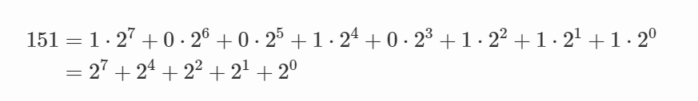

Scalar multiplication
Other than addition, we can define another operation
Scalar multiplication
n is a natural number
It may seem that computing $nP$ requires $n$ additions (Bad algorithm)
But there exist faster algorithms

Slide 15
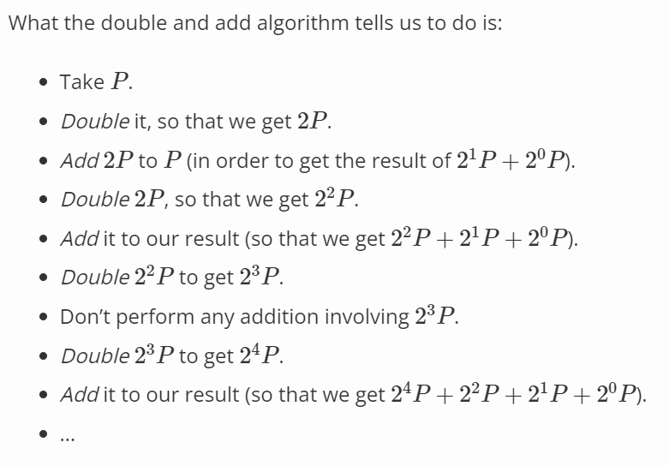
Scalar multiplication – Double and add
Double and add
In the end, we can compute $151∙P$ performing just seven doublings and four additions

Slide 16
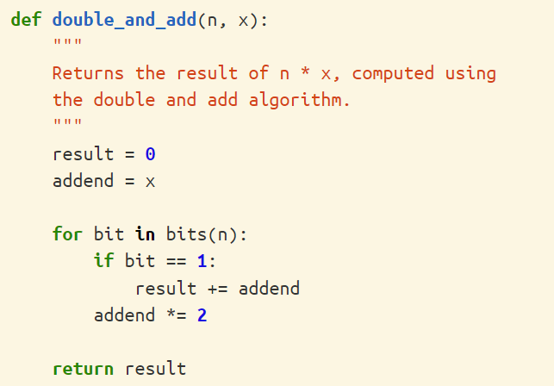
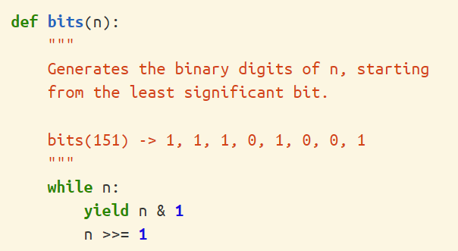
Scalar multiplication – Double and add
Double and Add python algorithm
Notes:
눈으로 보기엔 이 알고리즘이 더 좋을 게 없어보이는데 어디가 더 효과적이라는건지…

Slide 17
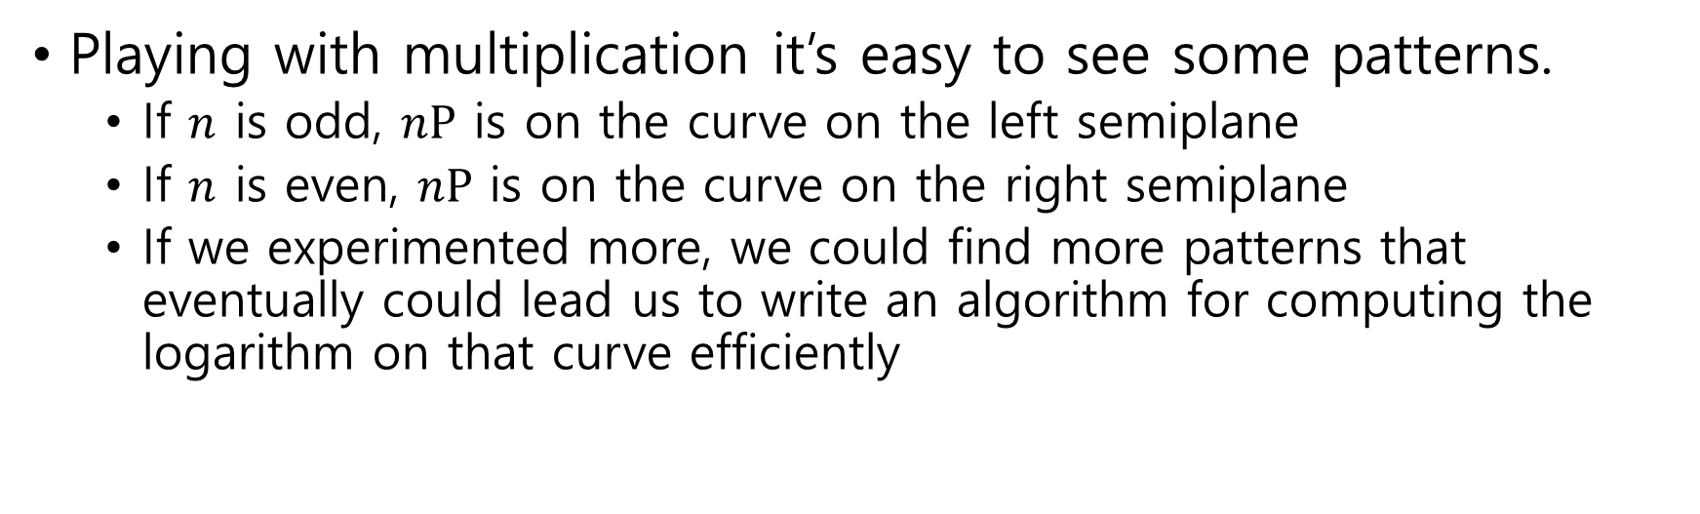
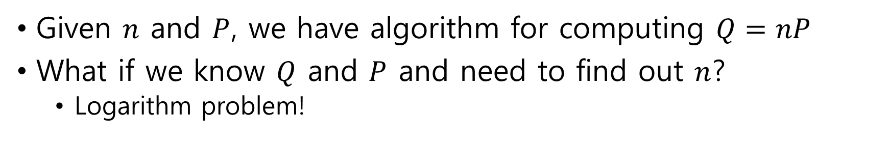
Logarithm(이산대수 문제)
Given $n$ and $P$, we have algorithm for computing $Q=nP$
What if we know $Q$ and $P$ and need to find out $n$?
Logarithm problem!
Playing with multiplication it’s easy to see some patterns.
If $n$ is odd, $nP$ is on the curve on the left semiplane
If $n$ is even, $nP$ is on the curve on the right semiplane
If we experimented more, we could find more patterns that eventually could lead us to write an algorithm for computing the logarithm on that curve efficiently
출처: https://andrea.corbellini.name/2015/05/17/elliptic-curve-cryptography-a-gentle-introduction/

Slide 18

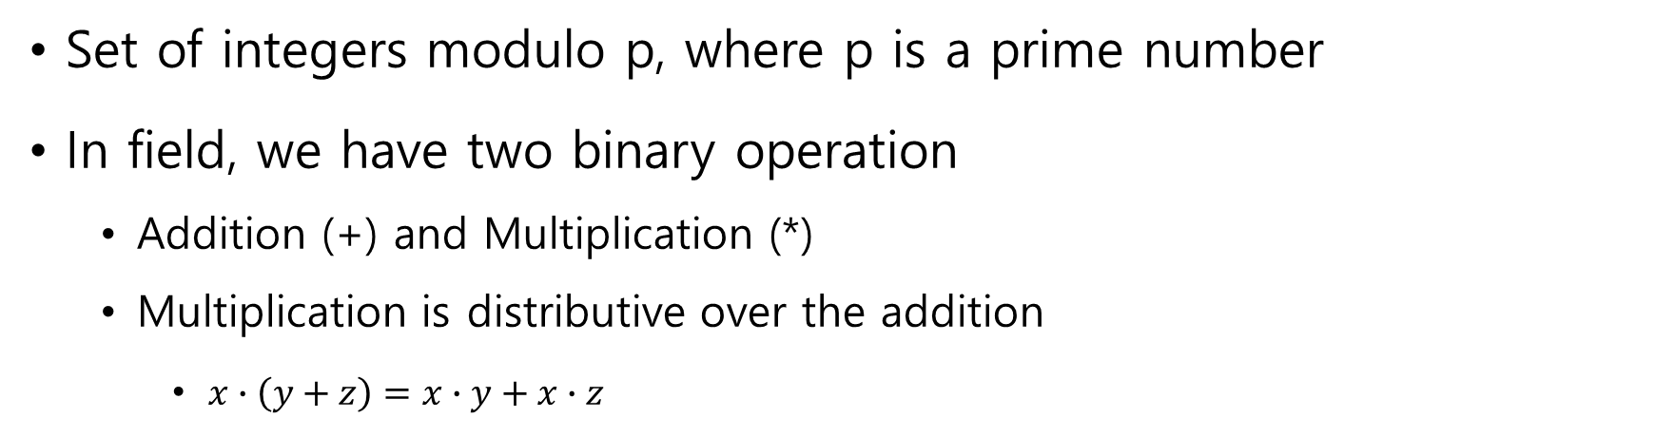

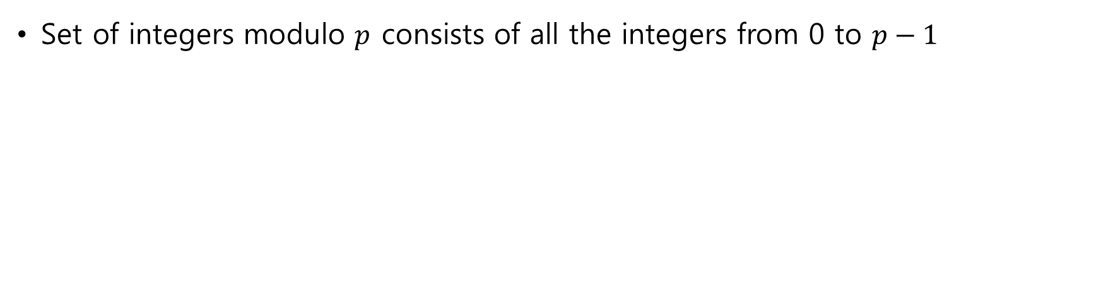
The field of integers modulo $p$
Set of integers modulo p, where p is a prime number
In field, we have two binary operation
Addition (+) and Multiplication (*)
Multiplication is distributive over the addition
$x∙\left(y+z\right)=x∙y+x∙z$
Set of integers modulo $p$ consists of all the integers from 0 to $p−1$

Slide 19
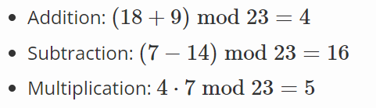
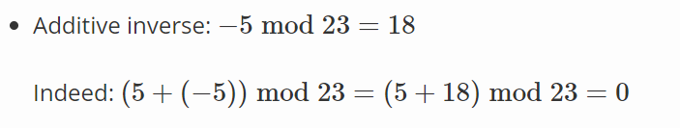
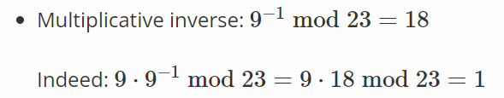
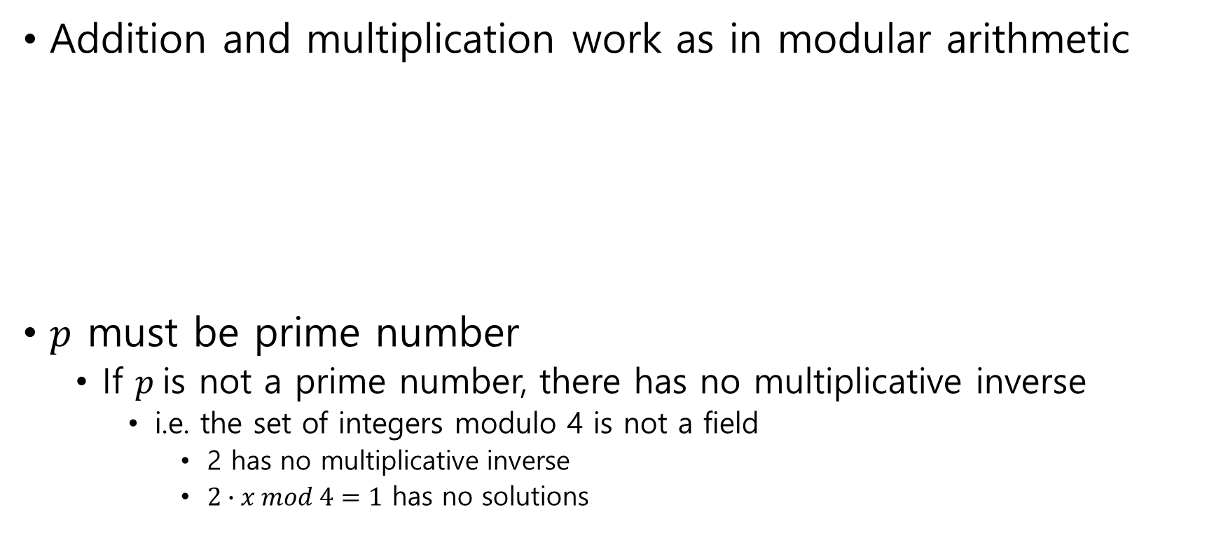
The field of integers modulo $p$
Addition and multiplication work as in modular arithmetic
$p$ must be prime number
If $p$is not a prime number, there has no multiplicative inverse
i.e. the set of integers modulo 4 is not a field
2 has no multiplicative inverse
$2∙x mod 4=1$ has no solutions

Slide 20
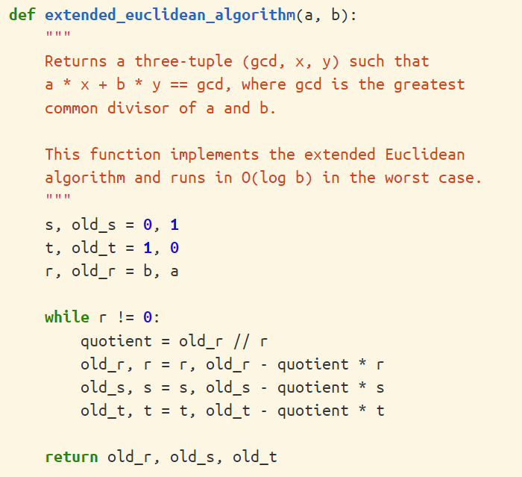
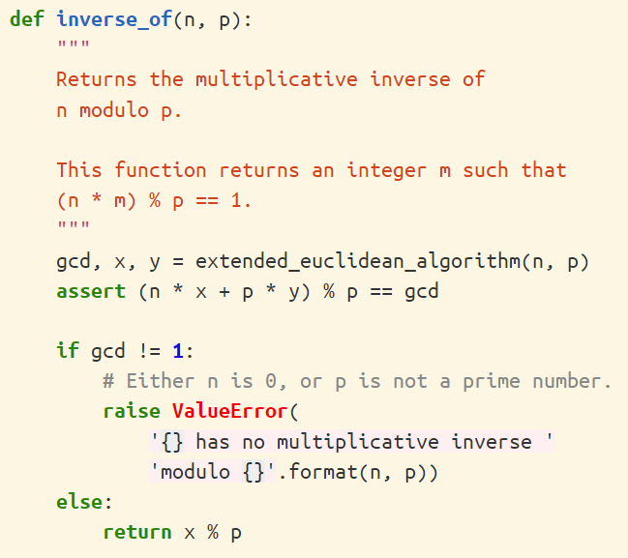
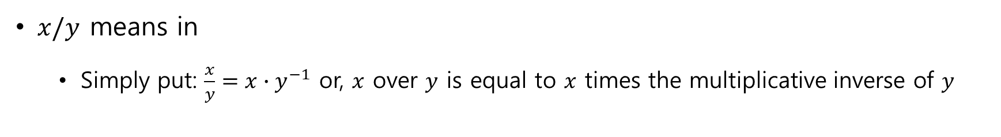

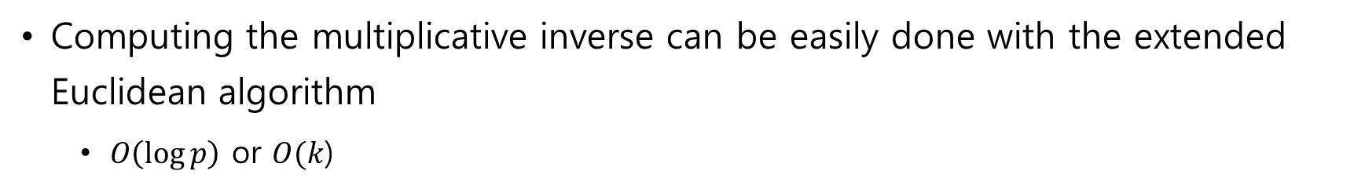
Division modulo $p$
$x/y$ means in
Simply put: $\frac{x}{y}=x∙y^{−1}$ or, $x$ over $y$ is equal to $x$ times the multiplicative inverse of $y$
Computing the multiplicative inverse can be easily done with the extended Euclidean algorithm
$O\left(\log{p}\right)$ or $O(k$)

Slide 21
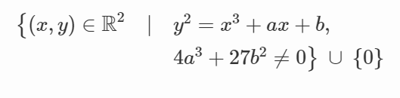
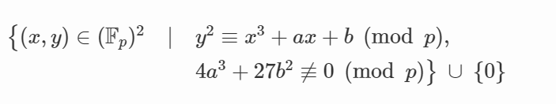

Elliptic curves in
Previous version
\
version
Where 0 is still the point at infinity, and $a$ and $b$ are two integers in

Slide 22
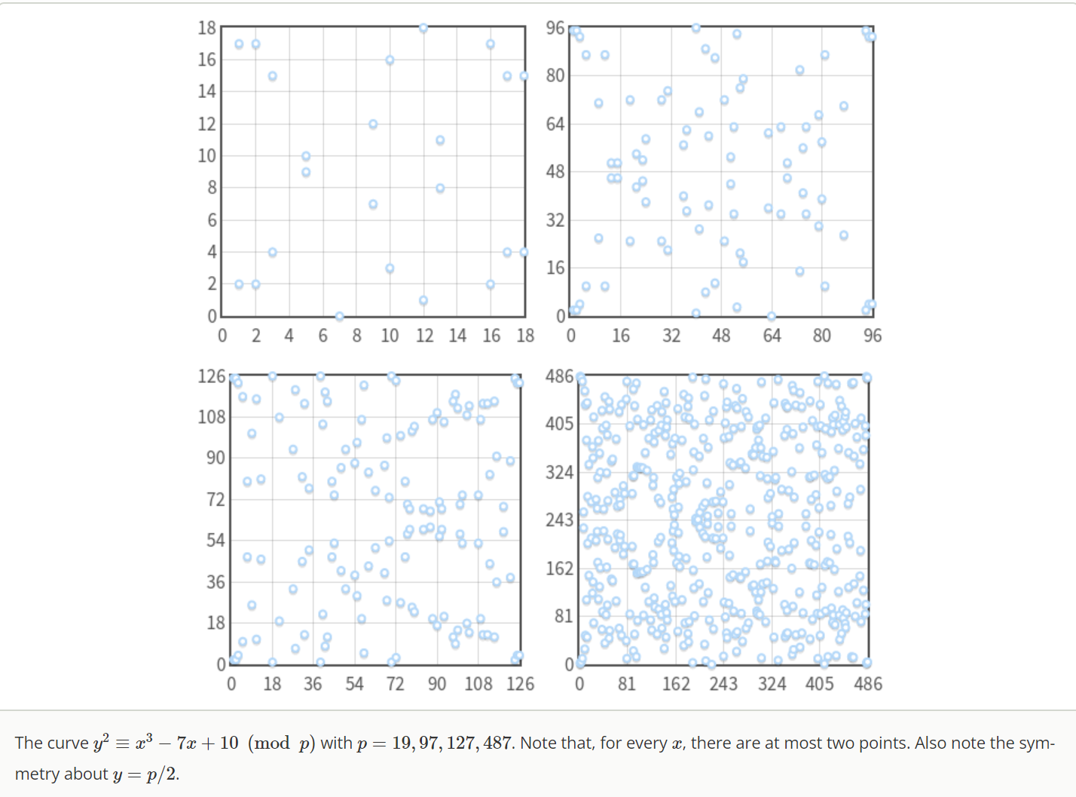
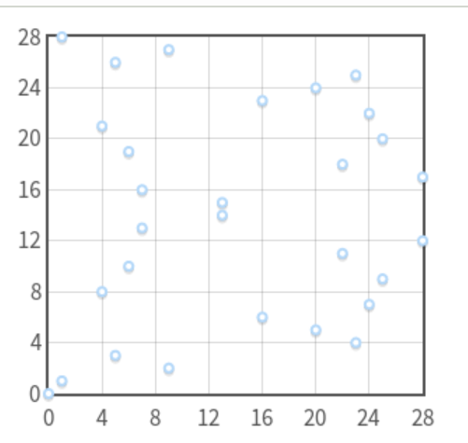
Elliptic curves in

Slide 23
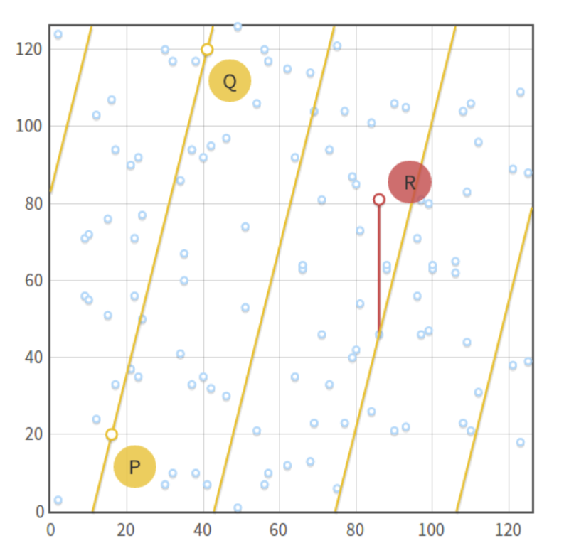
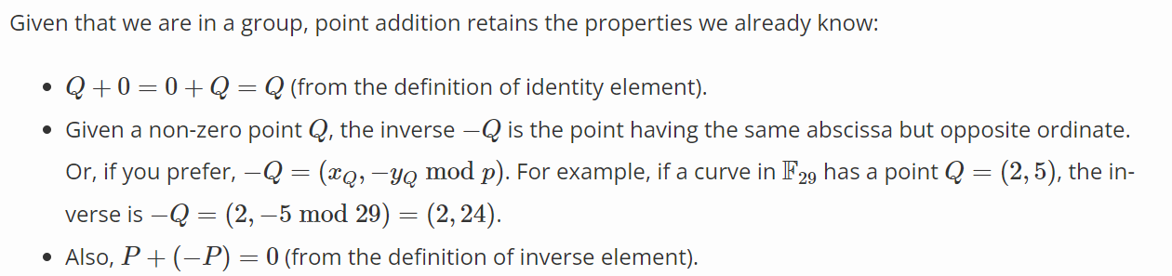
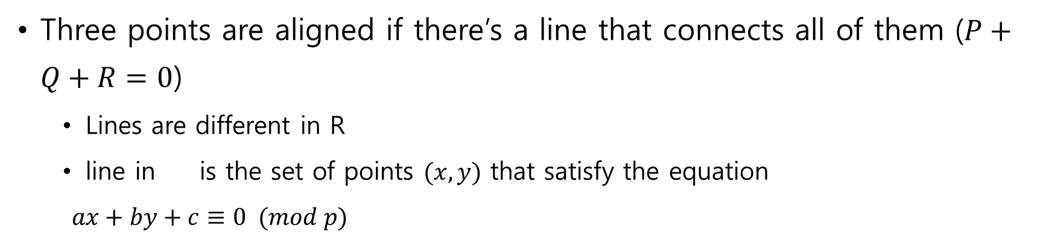
Point addition in
Three points are aligned if there’s a line that connects all of them ($P+Q+R=0$)
Lines are different in R
line in is the set of points $(x, y)$ that satisfy the equation
$ax+by+c≡0 (mod p)$

Slide 24
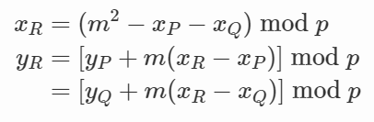
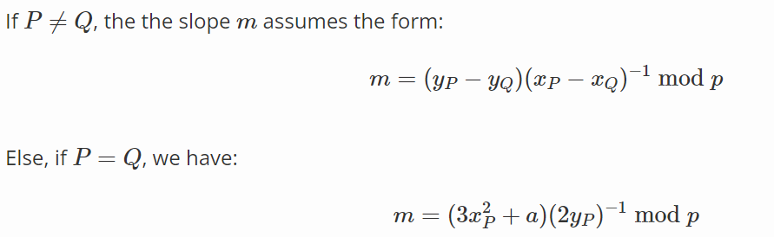
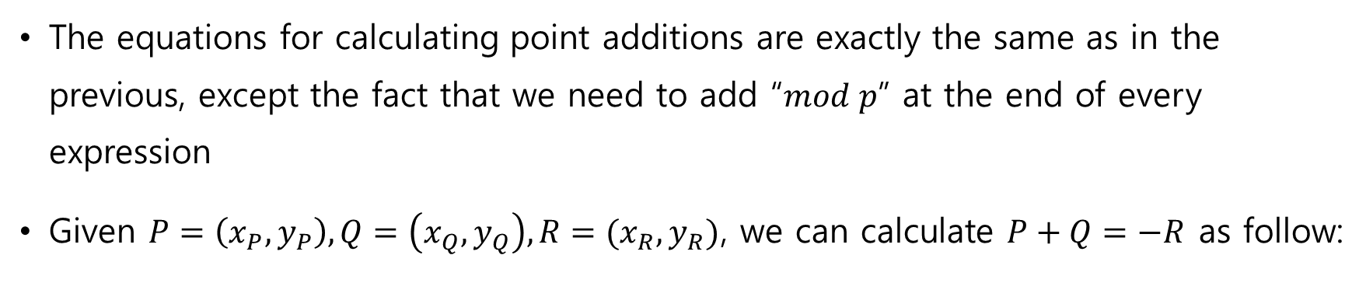
Algebraic sum
The equations for calculating point additions are exactly the same as in the previous, except the fact that we need to add “$mod p$” at the end of every expression
Given $P=\left(x_{P}, y_{P}\right), Q=\left(x_{Q}, y_{Q}\right), R=(x_{R}, y_{R})$, we can calculate $P+Q=−R$ as follow:

Slide 25
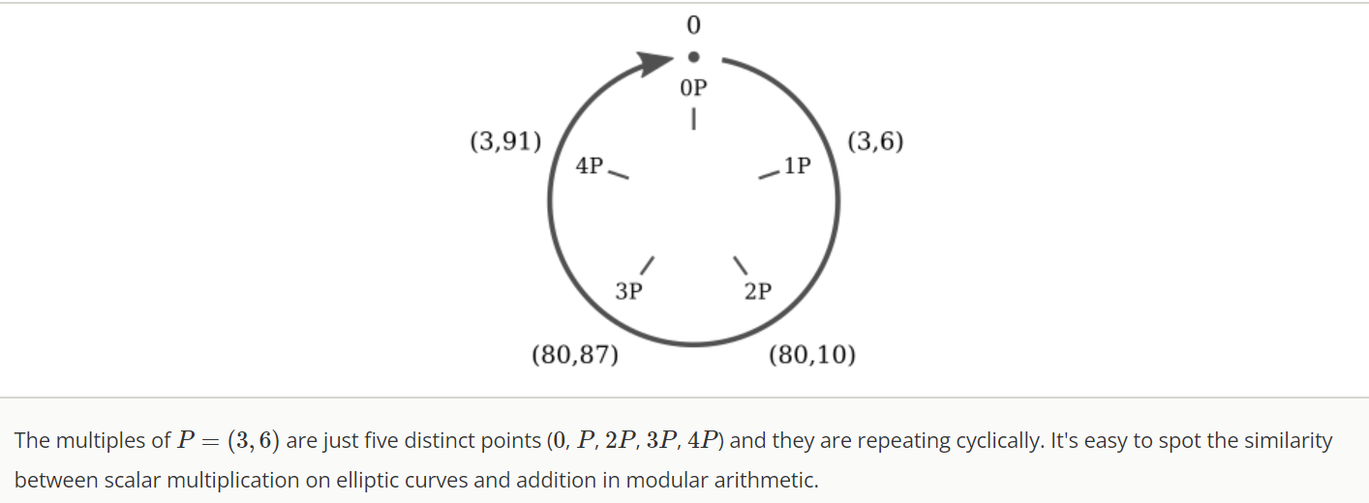

Scalar multiplication and cyclic subgroups

Slide 26


Scalar multiplication and cyclic subgroups

Slide 27


Scalar multiplication and cyclic subgroups

Slide 28



Subgroup order
What the order of a subgroup generated by a point $P$
Cyclic subgroup we can give a new definition: the order of $P$ is the smallest positive integer $n$ such that $nP=0$
The order of $P$ is linked to the order of the elliptic curve by Lagrange’s theorem, which states that the order of a subgroup is a divisior of the order of the parent group
These two information together give us a way to find out the order of a subgroup with base point $P$

Slide 29

Domain Parameters
Elliptic curve algorithms will work in a cyclic subgroup of an elliptic curve over a finite field
Algorithm will need the parameter
The prime $p$ that specifies the size of the finite field
The coefficients $a$ and $b$ of the elliptic curve equation
The base point $G$ that generates our subgroup
The order $n$ of the subgroup
The cofactor $h$ of the subgroup
Domain parameters for our algorithms are the sextuple ($p, a, b, G, n, h$)

Slide 30


Random curves
Some classes of elliptic curves that are particularly weak
All the curves that have $p=hn$ (the order of the finite field is equal to the order of the elliptic curve) that are vulnerable to Smart’s attack, which can be used to solve discrete logarithms in polynomial time on a classical computer
How can we assure that the curve is safe?
Use additional domain parameter: the seed $S$
$S$ is a random number used to generate the coefficients $a$ and $b,$ or the base point $G$, or both

Slide 31



Random curves
$a, b, G$ are generated by computing the hash of the seed S
Hashes are “easy” to compute, but “hard” to reverse
A curve generated through a seed is said to be verifiably random
Known as “nothing up my sleeve”
The curve has not been specially crafted to expose vulnerabilities known to the author

Slide 32


Elliptic Curve Cryptography
The private key is a random integer $d$ chosen from $\{1, …, n−1\}$ (where $n$ is the order of the subgroup)
The public key is the point $H=dG$ (where $G$ is the base point of the subgroup)
If we know $d$ and $G$(along with the other domain parameters), finding $H$ is “easy”
But if we know $H$ and $G$, finding the private key $d$ is “hard”
Discrete logarithm problem

Slide 33
Encryption with ECDH
ECDH is a variant of the Diffie-Hellman algorithm for elliptic curve
Key agreement protocol, more than an encryption algorithm
ECDH defines how keys should be generated and exchanged between parties
The problem it solves is the following: two parties want to exchange information securely, so that a third party (the Man In the Middle) may intercept them but may not decode them.

Slide 34


Encryption with ECDH
Alice and Bob generate their own private and public keys
Alice: $d_{A}$ for private key, $H_{A}=d_{A}G$ for public key
Bob: $d_{B}$ for private key, $H_{B}=d_{B}G$ for public key
Both are using the same domain parameters: the same base point $G$ on the same elliptic curve on the same finite field
Alice and Bob exchange their public keys $H_{A}$ and $H_{B}$ over an insecure channel
Man In the Middle would intercept $H_{A}$ and $H_{B}$, but won’t be able to find out nither $d_{A}$ nor $d_{B}$ without solving the discrete logarithm problem

Slide 35



Encryption with ECDH
3. Alice and Bob calculate the shared secret S
Alice calculates $S=d_{A}H_{B}$(using her own private key and Bob’s public key)
Bob calculates $S=d_{B}H_{A}$(using his own private key and Alice’s public key)
$$S=d_{A}H_{B}=d_{A}\left(d_{B}G\right)=d_{B}\left(d_{A}G\right)=d_{B}H_{A}$$
This is known as the Diffie-Hellman problem, which can be started as follow
Given three points $P, aP$ and $bP$, what is the result of $abP$
Given three integers $k, k^{x}$ and $k^{y}$, what is the result of $k^{xy}$?
The Diffie-Hellman key exchange: Alice and Bob can “easily” calculate the shared secret, the Man in the Middle has to solve a “hard” problem

Slide 36
Encryption with ECDH
Diffie-Hellman problem for elliptic curves is assumed to be a “hard” problem
Solving the logarithm problem is a way of solving the Diffie-Hellman problem
Now Alice and Bob have obtained the shared secret, they can exchange data with symmetric encryption

Slide 37
Ephemeral ECDH
ECDHE
“E” in ECDHE stands for “Ephemeral(일시적인)” and refers to the fact that the keys exchanged are temporary
Used in TLS, where both the client and the server generate their public-private key pair on the fly
Keys are signed with the TLS certificate (for authentication) and exchanged between the parties

Slide 38

ECDSA
Alice : select Private key $d_{A}$, calculate $H_{A}$ = $d_{A}G$
Calculate $e=HASH\left(m\right)$
$z$는 $e$의 왼쪽 $L_{n}$ 비트
Take cryptographically secure random integer $k$ from {1, …, n-1}
Calculate ($x_{1}$, $y_{1}$) = $kG$
$r= x_{1} mod n$, If $r=0$, go back to step 3
$s= k^{−1}\left(z+rd_{A}\right) mod n$, if $s=0$, go back to step 3
Signature : ($r, s$)

Slide 39

ECDSA
Bob : verification algorithm
다음 3개를 확인 $H_{A}$ ≠ $0$, $H_{A}$ on the curve, ${n∗H}_{A}=0$
$r, s 가$ [1, n-1] 범위에 있으면 정상, 아니면 비정상
Calculate $e=HASH\left(m\right)$
$z$는 $e$의 왼쪽 $L_{n}$ 비트
Calculate $w= s^{−1} mod n$
$u_{1}=z w mod n, u_{2}=r w mod n$
($x_{1}$, $y_{1}$) $=u_{1}∗G+u_{2}∗H_{A}$, ($x_{1}$, $y_{1}$) = 0 면 invalid
The signature is valid only if $r= x_{1} mod n$

Slide 40

ECDSA
다른 메시지를 사인한 두 명의 K가 같은 경우 위험성
다음 3개를 확인 $H_{A}$ ≠ $0$, $H_{A}$ on the curve, ${n∗H}_{A}=0$
$r, s 가$ [1, n-1] 범위에 있으면 정상, 아니면 비정상
Calculate $e=HASH\left(m\right)$
$z$는 $e$의 왼쪽 $L_{n}$ 비트
Calculate $w= s^{−1} mod n$
$u_{1}=z w mod n, u_{2}=r w mod n$
($x_{1}$, $y_{1}$) $=u_{1}∗G+u_{2}∗H_{A}$, ($x_{1}$, $y_{1}$) = 0 면 invalid
The signature is valid only if $r= x_{1} mod n$

Slide 41


Schnorr signature
Schnorr signature
A cyclic group G of prime order p
A generator $g$ of G
A hash function H
Private/public key pair $\left(x, X\right)∈\left\{0, p−1\right\}×G where X=g^{x}$
Signing message m
Select $r$ in $Z_{p}$
Compute $R= g^{r}$, $c=H\left(X, R, m\right), s=r+cx$
Signature : ($R, s$)
Verify : $g^{r}=RX^{c} (=g^{r}X^{c}=g^{r}g^{xc}=g^{r}g^{x(s−r)/x}=g^{s})$

Slide 42

Schnorr signature
Naive way Multi-sign : n signer with a message m
$L=\left\{X_{1}=g^{x_{1}}, …,X_{n}=g^{x_{n}}\right\}$ set of public key
$R= \prod_{i=1}^{n}{R_{i}} :R_{i}$ = $g^{r_{i}}$
$c=H\left(\tilde{X}, R, m\right): \tilde{X}$ = $\prod_{i=1}^{n}{X_{i}}$
$s=\prod_{i=1}^{n}{s_{i}} mod p$ : $s_{i}=r_{i}+cx_{i}$
Signature : ($R, s$)
Verify : $g^{s}=R{\tilde{X}}^{c}$
Rogue-key attack에 취약

Slide 43


EC-Schnorr signature
Key generation $\left(sk, pk \right) ∈\left\{1, n−1\right\}, where pk=sk∗G$
Signing message m
Select $k$ in $\left\{1, n−1\right\}$
$Q=kG$
$r=H\left(Q\left|\left|pk\right|\right|m\right) mod n$
$s=k −r ∗sk mod n$
Verify
$Q=sG+r∗pk=\left(k−r∗sk\right)G+r∗sk∗G$
$v=H\left(Q\left|\left|pk\right|\right|m\right) mod n$
If $v=r$ return 1, else 0

Slide 44

EC-Schnorr multi-signature
Key generation $\left(sk, pk \right) ∈\left\{1, n−1\right\}, where pk=sk∗G$
Signing message m
Select $k_{i}$ in $\left\{1, p−1\right\}$
$Q=k_{i}G$
$Pk= \prod_{i=1}^{n}{{pk}_{i}}$
$Q= \prod_{i=1}^{n}{Q_{i}}$
$r=H\left(Q\left|\left|pk\right|\right|m\right) mod p$
$s_{i}=k_{i}−r ∗sk_{i} mod p$
$S= \sum_{i=1}^{n}{S_{i}}$
Signature: $\left(r, S\right)$

Slide 45

EC-Schnorr multi-signature
Verify
$Q=SG+r∗Pk$
$v=H\left(Q\left|\left|Pk\right|\right|m\right) mod p$
If $v=r$ return 1, else 0

